Slide 1
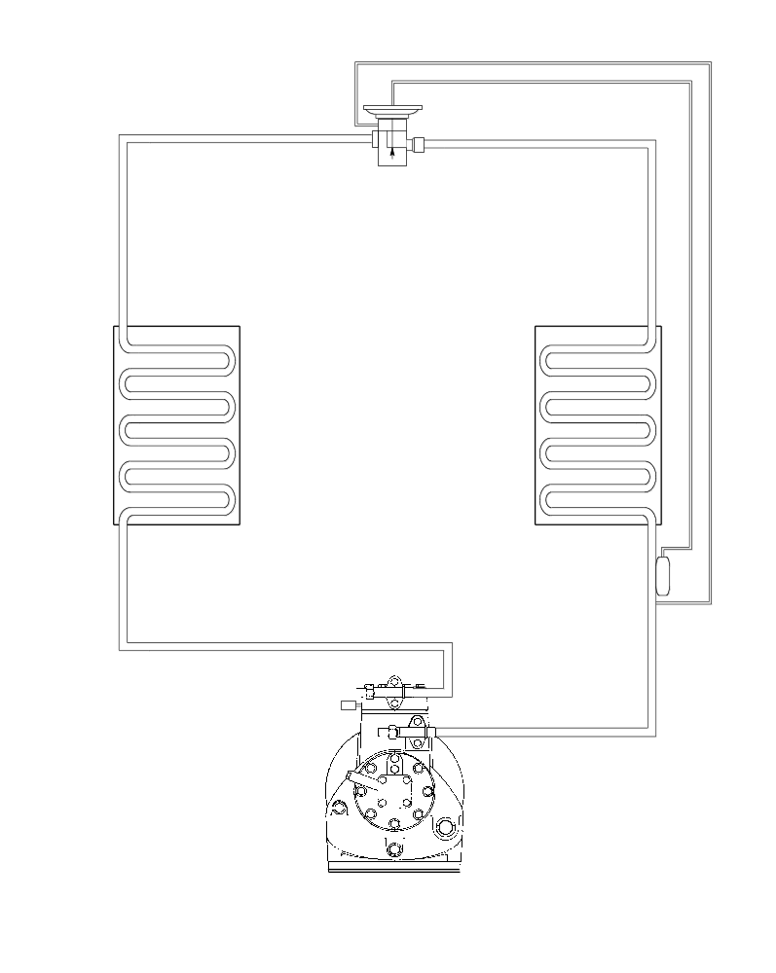
Basic
Refrigeration
System
4 Component Flow Diagram

Slide 2
The High Side

Slide 3
Thermal Expansion Valve
HT HP
HT HP
Condenser
HT HP
Discharge
Service
Valve
Compressor
Legend
HT HP
HT HP
HT HP
The High Side

Slide 4
The Low Side

Slide 5
Equalization Line
Thermal Expansion Valve
Flash Gas
LT LP
Evaporator
TXV Bulb
LT LP
Compressor
Suction
Service Valve
Legend
LT LP
LT LP
The Low Side

Slide 6
The System

Slide 7
High Side
Conditioned Space
Ambient
Air
Return
Air
Supply Air
Low Side

